Slide 1
ERICH & MICHAEL’S WEDDING
MAY 23RD, 2026
100 GUESTS
CHÂTEAU DE SAINT-MARTIN DU TERTRE
WEDDING MOOD BOARD

Slide 2
COLOR PALETTE
MAY 23RD, 2026:
CEREMONY: WHITE/GREENERY
COCKTAIL & RECEPTION/DINNER: WHITE/GREENERY

Slide 3
SIGNS
Audrey’s note: To create an harmony between the differents signage I recommend using the same font style and color (as much as possible) – TBC with Erich or Michael a design proof will be sent.

Slide 4
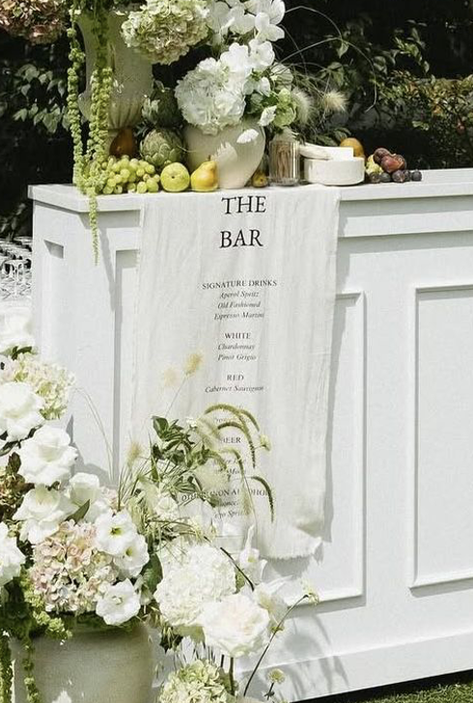
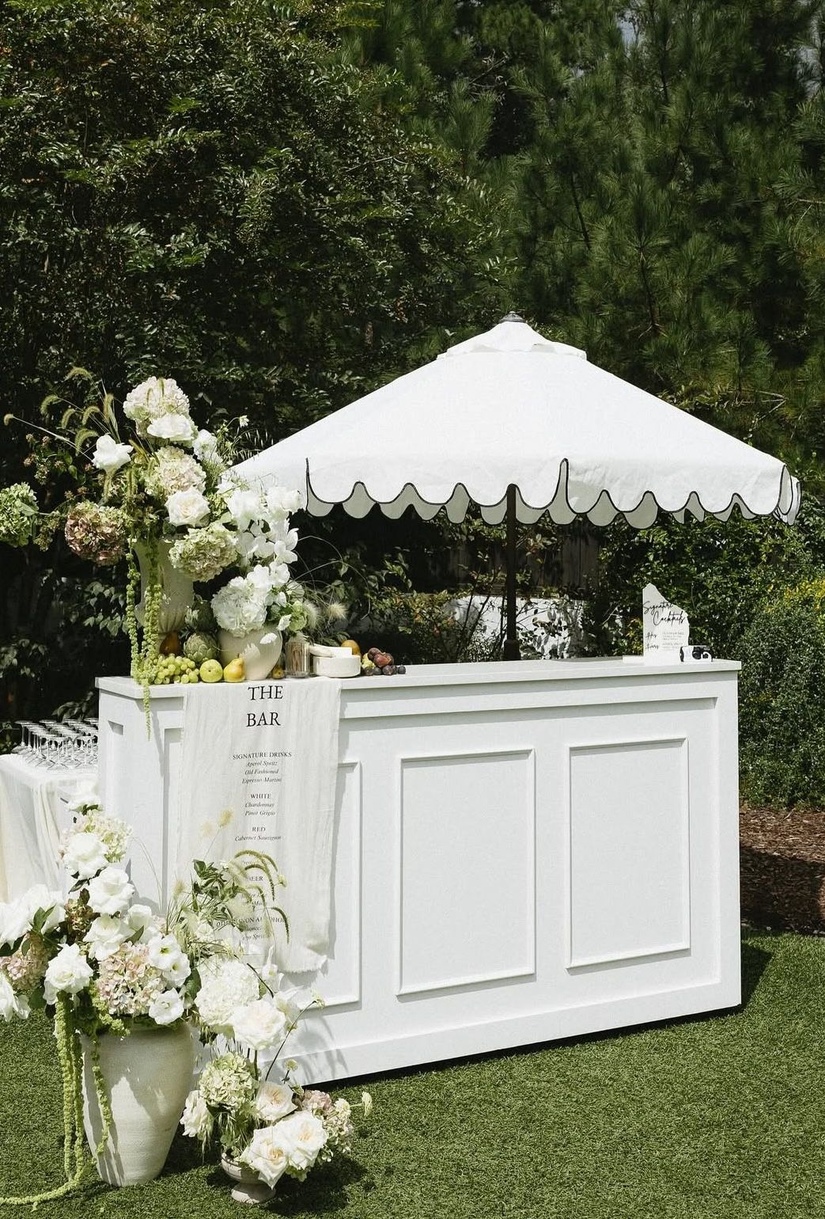
BARS MENU
A bespoke banner will be designed and printed, showcasing the selected beverages
The décor will echo the reference imagery, styled in harmony with the color palette detailed on slide #2

Slide 5
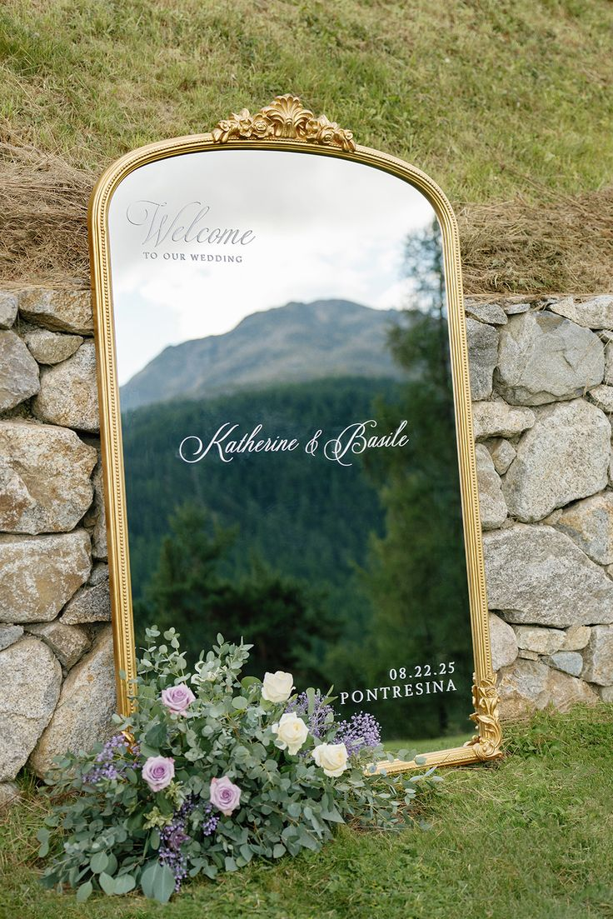
Welcome Sign
A Baroque-style gold mirror will elegantly showcase the groom and groom’s names in white script, alongside the wedding date, radiating timeless sophistication and refined elegance

Slide 6
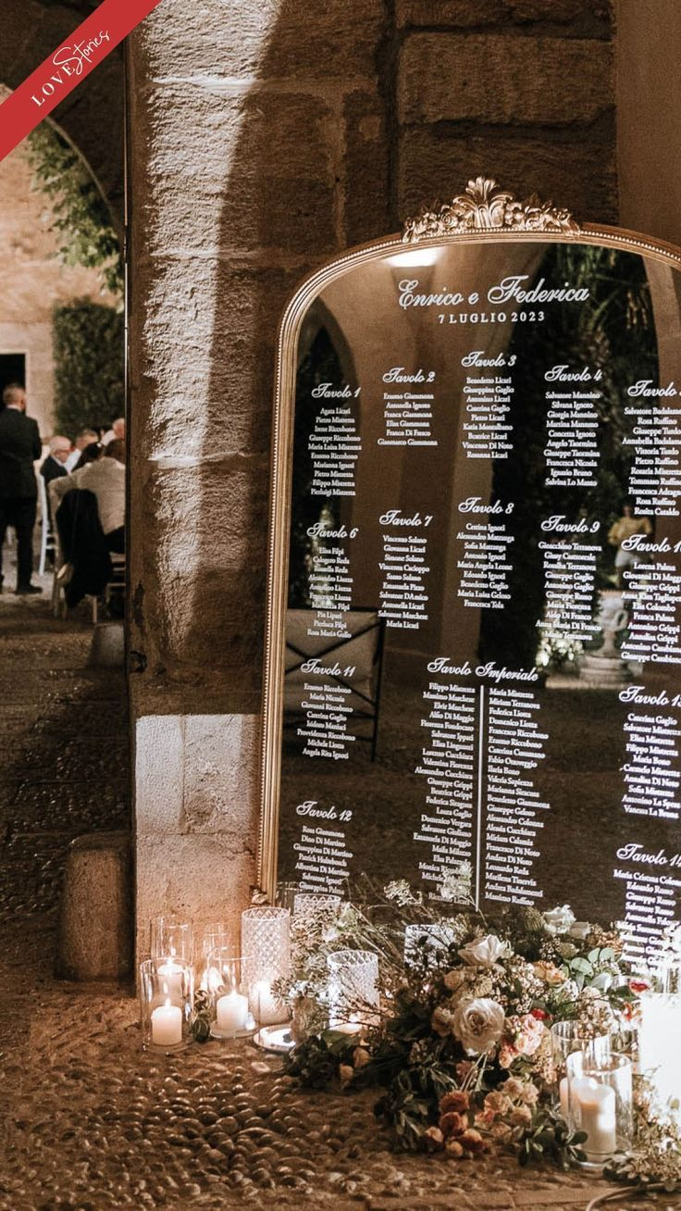
Seating Chart
A large rectangular mirror with a gold frame will display the seating chart, featuring white script typography elegantly presenting each table number and guest names
A medium-sized floral arrangement will be displayed at the base of the seating chart, accompanied by candles of varying heights, with décor reflecting the reference imagery and styled in harmony with the color palette detailed on slide #2

Slide 7
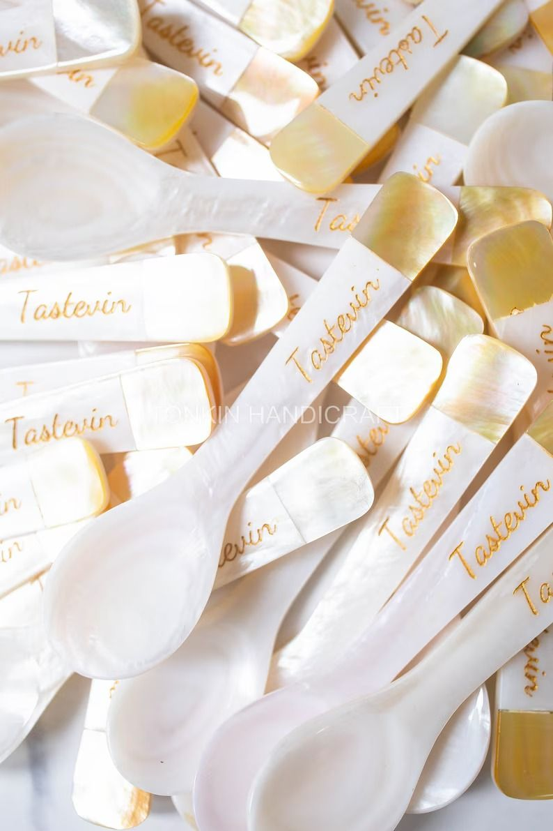
Place Cards
Audrey’s Note:
Please note that place cards are required by the catering staff regardless of round or rectangular tables. For weddings with more than 100 guests, place cards must be placed on each table with assigned seating, showing each guest’s full name, table number, and a meal icon/allergy note to guide the staff.

Slide 8
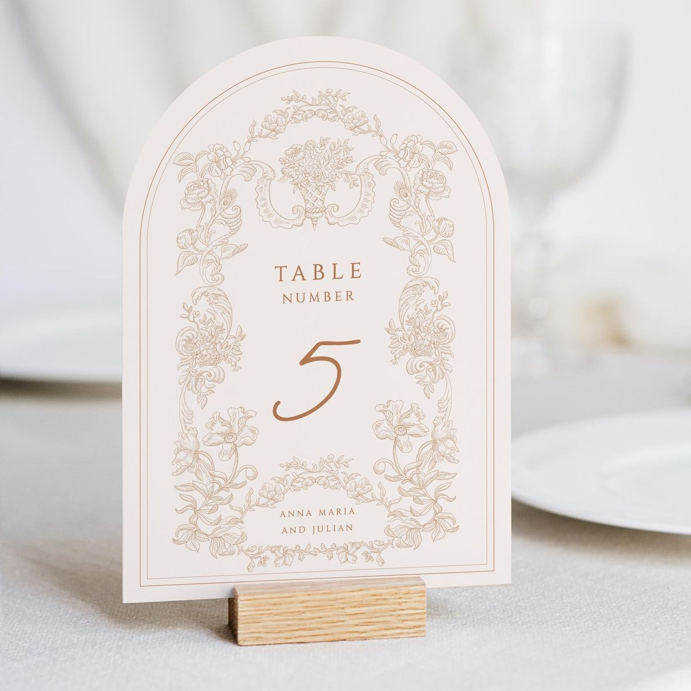
Table numbers
A refined rectangular design with a rounded top, printed on warm white paper and adorned with delicate light brown floral motifs and dark brown script typography, will be elegantly presented on a wooden holder.

Slide 9
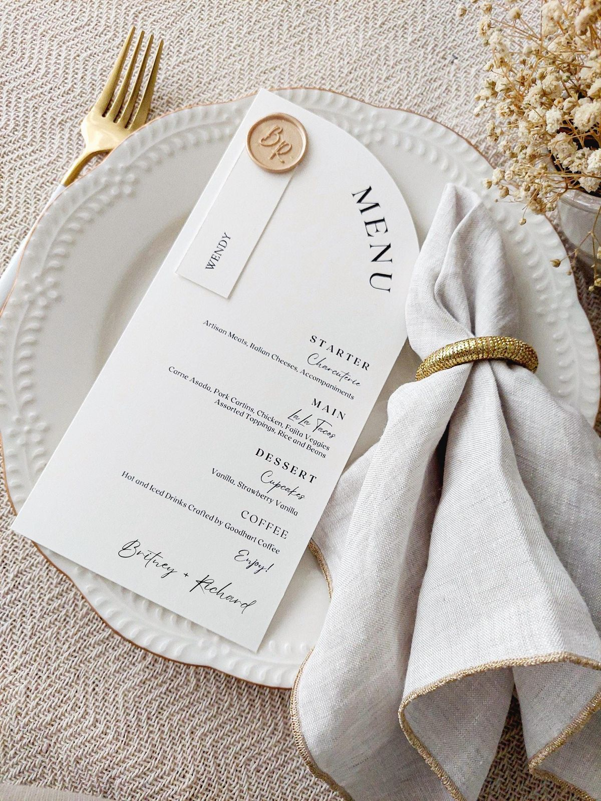
Menus
A large rectangular design with a rounded top, crafted from smooth, thick white matte paper, adorned with elegant dark script typography and finished with a gold wax stamp, creating a refined and harmonious statement

Slide 10
NOTES POUR DESIGNER/IMPRIMEUR:
4 Numeros de tables (1-2-3-4)
2 Bars signs (1 pour le cocktail - 1 pour la réception/fête)
Tu peux aussi proposer une option plus simple avec un cadre doré a poser sur le bar
1 welcome sign + mirroir a fournir
Tu peux aussi proposer une 2ieme option avec le plus petit mirroir baroque par example
1 Seating chart avec mirroir a fournir – ordre alphabetique
Tu peux aussi propsoer une 2ieme option comme pour l’aveille de Veronica et colin (suspend avec la structure doré - dailleur je pense te donner la mienne car je ne m’en sert pas et cela pourra t’etre utile dis moi si ca te vas et je te l’a fait ramener au prochain marriage”
108 place cards ‘cuilleres nacre caviar”
108 place cards simple, avec le meme style et couleur que les numero de table
108 menus ( tous les style doivent la aussi concorder)

